Slide 1
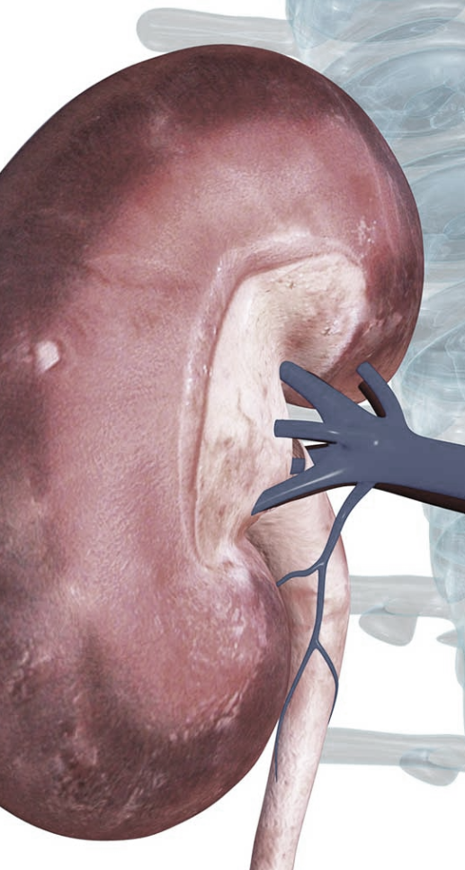
Kidney-Genetics
Labmeeting
2023-12-05 AG Halbritter

Slide 2
Kidney-Genetics
Status quo
Objective
10 – 30% of patients with kidney failure have a family history¹
~ 700 mendelian disease genes
Aim
Design a reproducible, automatically updatable, curated and publicly available list of all relevant kidney associated genes
Current status
Manual curation of high evident genes
Building an easy-to-use web interface
Problem: no unified and up-to-date database of kidney associated genes
Solution: Kidney-Genetics
standardized
automated
publicly accessible
regularly updated
1 Groopman et al. Genomic medicine for kidney disease. Nature Reviews Nephrology, 2018

Slide 3
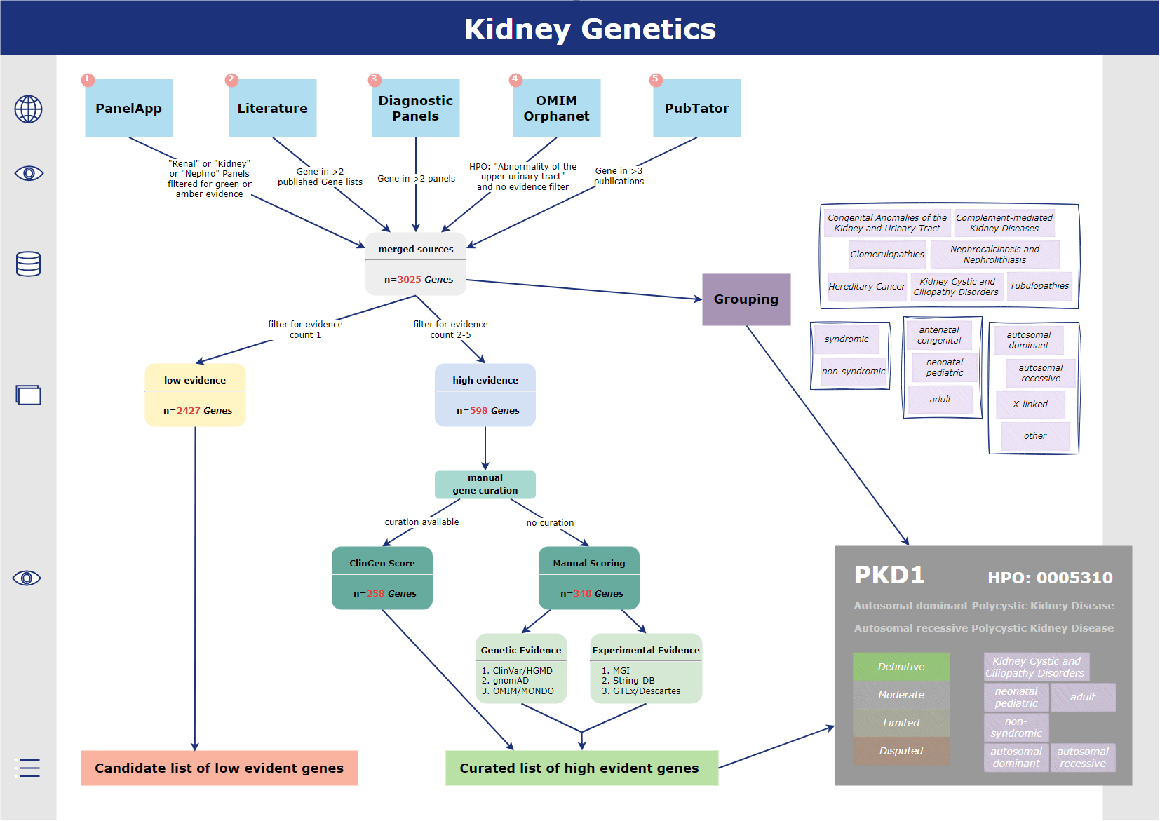
Overview
Status quo
Flowchart:

Slide 4
Methods
PanelApp
Literature
Diagnostic Panels
OMIM/Orphanet
PubTator
Evidence criteria
Candidate genes
High-evidence genes

Slide 5
Results
PanelApp
Literature
Diagnostic Panels
OMIM/Orphanet
PubTator
534
822
956
789
2158
3025 genes
Evidence filter
478
491
550
791
752
1454 genes
1530
897
2427 candidate genes
598 high-evidence genes
164
189
131
114
0
1
2
3
4
5
Evidence Count

Slide 6
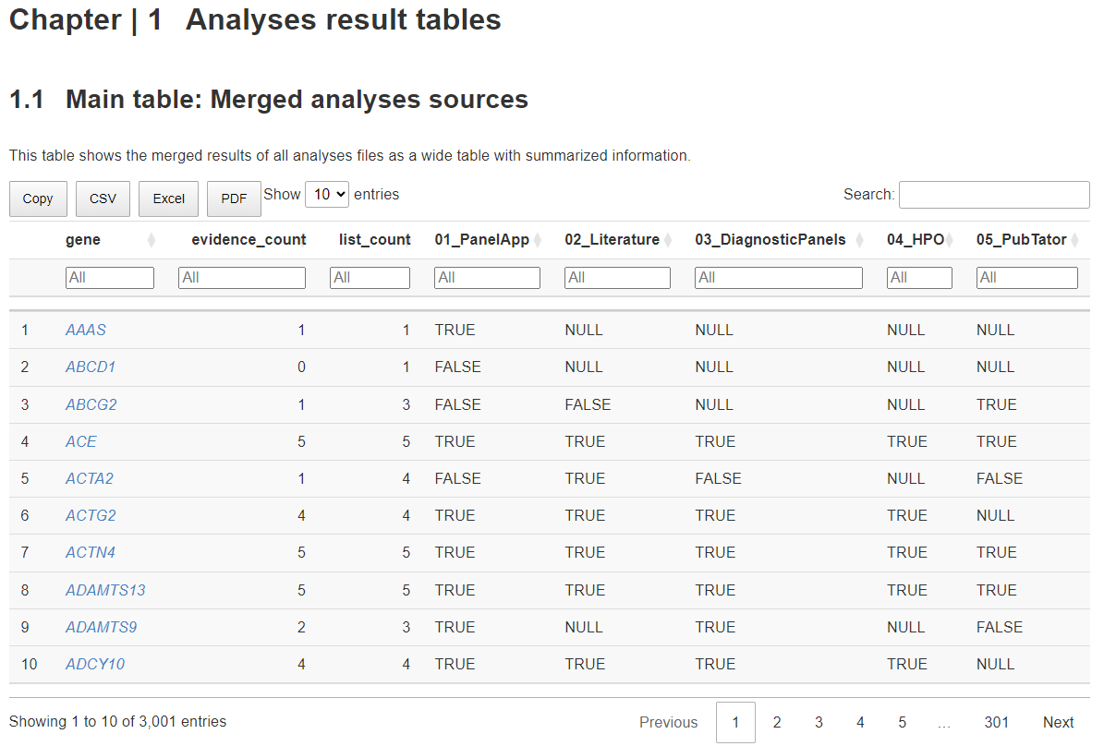
Kidney-Genetics
Status quo
Current status
Publicly accessible GitHub page with all code
kidney-genetics.org
We document all steps there to make it as reproducible as possible
Annotation of Genes
https://halbritter-lab.github.io/kidney-genetics/

Slide 7
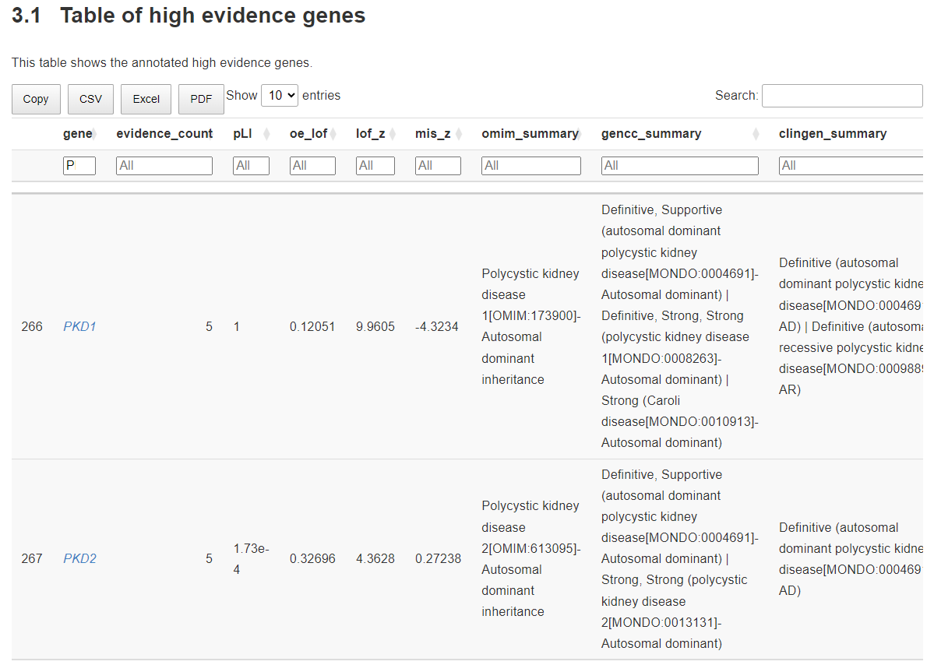
Kidney-Genetics
Status quo
Perspective
Manual curation of the 598 high-evidence genes
Clingen curation available in 258 Genes
Setting up a GoogleSheets with the Curation Workflow and Instructions → maybe develop a WebApp to simplify the curation process
https://halbritter-lab.github.io/kidney-genetics/

Slide 8
Methods
Status quo
Flowchart:

Slide 9
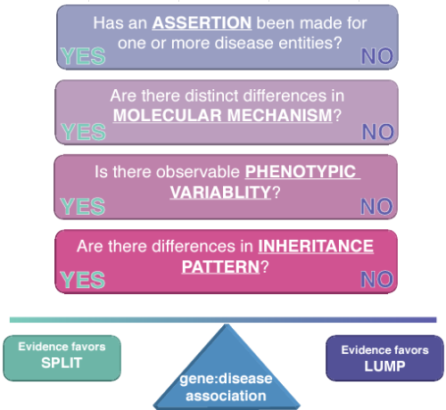
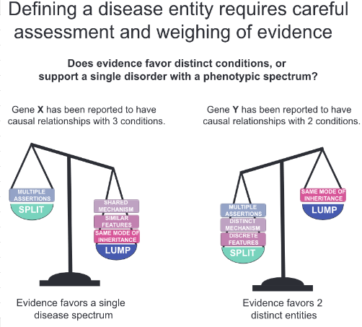
Methods
Pre-Curation:
Rehm et al. ClinGen The Clinical Genome Resource. NEJM, 2015

Slide 10
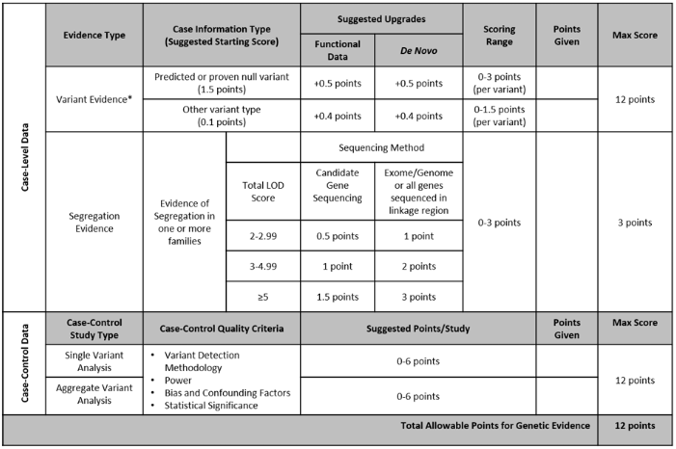
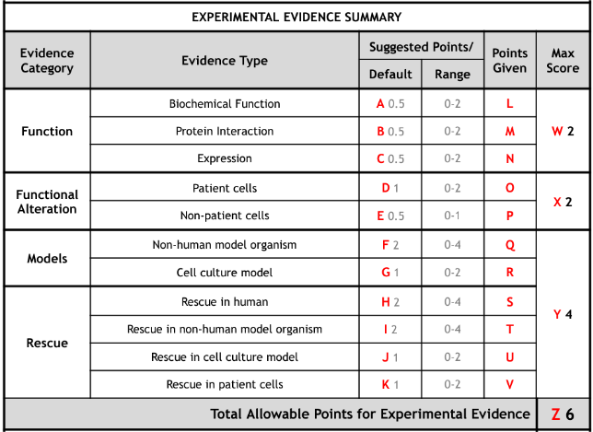
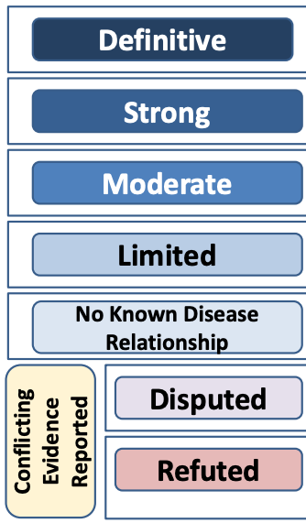
Methods
Genetic evidence + Experimental evidence => Classification
Rehm et al. ClinGen The Clinical Genome Resource. NEJM, 2015

Slide 11
Kidney-Genetics
Status quo
Problem: no unified and up-to-date database of kidney associated genes
What‘s coming next?
Manual curation of high evident genes with a standardized workflow in GoogleSheets
Determination of the point system with points analogous to the ClinGen assignment system
Refinement of the GitHub page with clear documentation and a user-friendly interface → kidney-genetics.org
Solution: Kidney-Genetics
standardized
automated
publicly accessible
regularly updated
1 Groopman et al. Genomic medicine for kidney disease. Nature Reviews Nephrology, 2018

Slide 12
Any questions?

